Slide 1

CAB Geometry
By: My son Caleb Goodrich, Da Huo, and my best friend forever Chase Zerkle

Slide 2
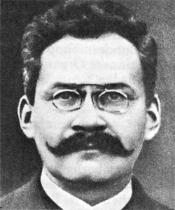
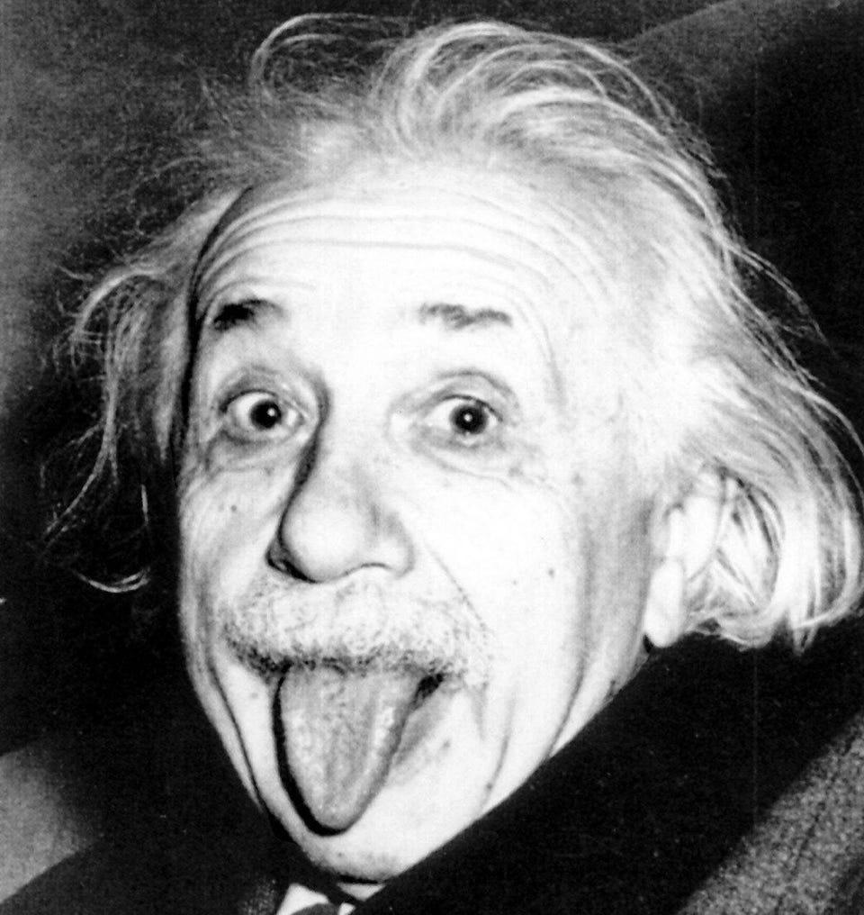
The father of Taxicab geometry.
Taught Einstein.
Laid mathematical foundation for theory of relativity.
Pretty cool dude.
Hermann Minkowski
1864-1909
“Oh, that Einstein, always skipping lectures… I certainly never would have thought he could do it.”
“The mathematical education if the young physicist [Albert Einstein] was not very solid, which I am in a good position to evaluate since he obtained it from me in Zurich some time ago.”

Slide 3
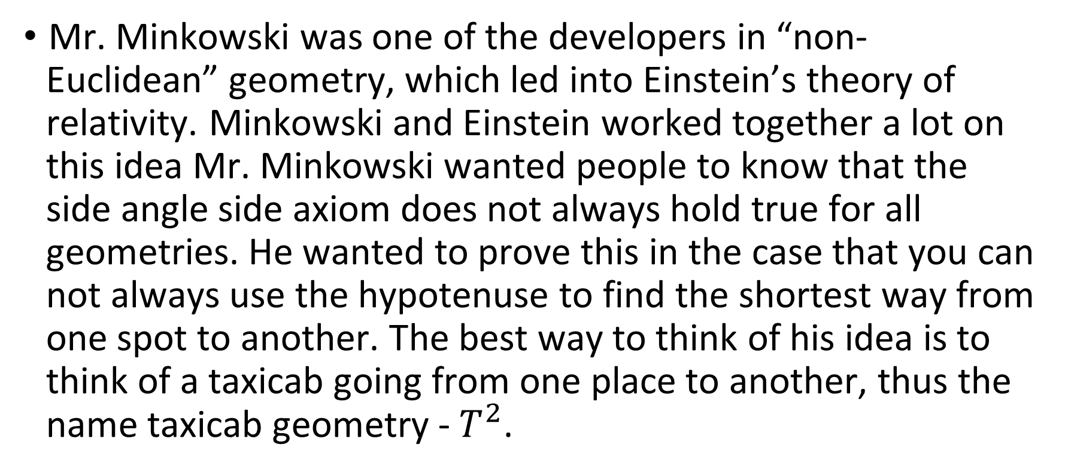

Slide 4

A form of geometry in which the usual distance function of metric or Euclidean geometry is replaced by a new metric in which the distance between two points is the sum of the absolute difference of their Cartesian coordinates. A great example is thinking you are a taxi driver in a place like Barcelona and using the diagonal route from point A to point B because it is the shortest route possible. Taxicab geometry is a non-Euclidean geometry that is accessible in a concrete form and is only one axiom away from being Euclidean in its basic structure. The points are the same, the lines are the same, and angles are measured the same way. Only the distance function is different.

Slide 5

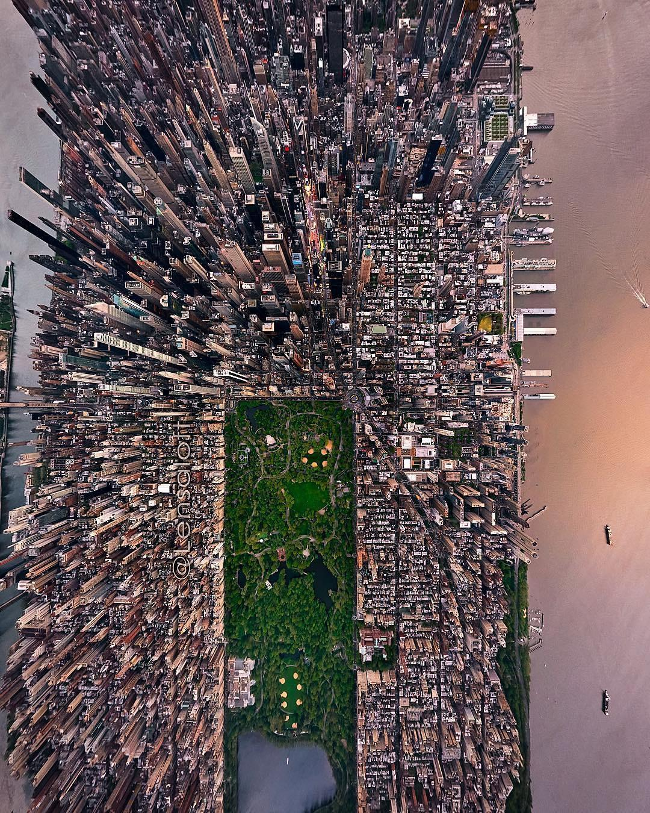
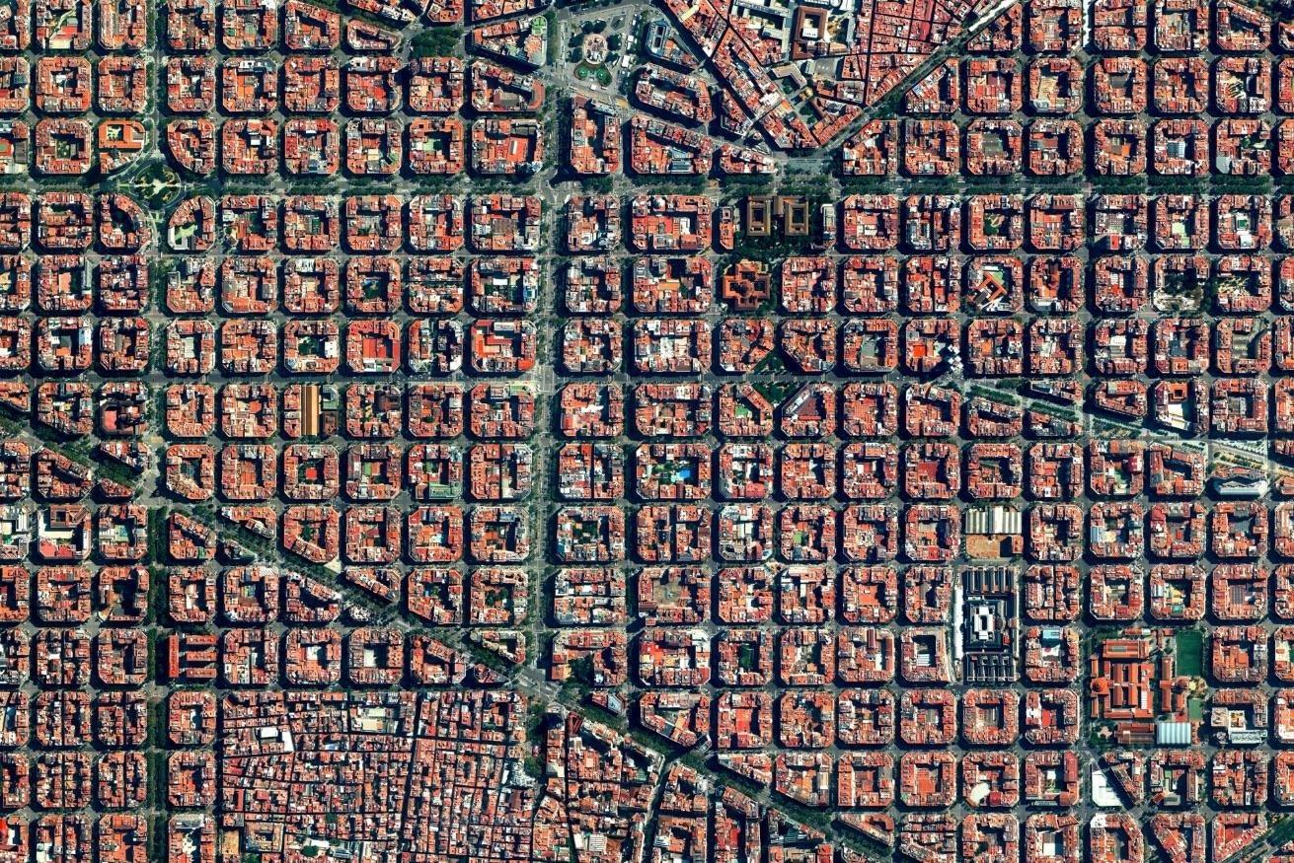

Slide 6

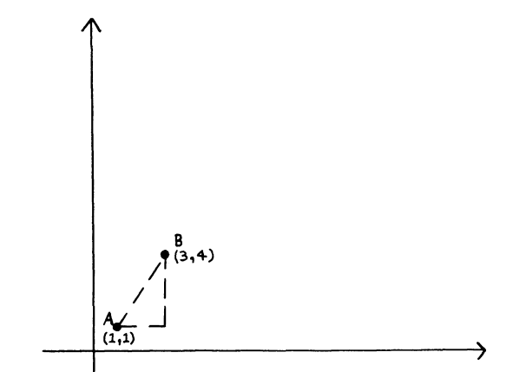
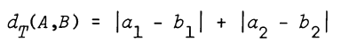
The distance formula that we are accustomed to using in Euclidean geometry will not work for the shortest distance. Finding the Euclidean distance from one location in a town to another that is on a different street will not produce an accurate depiction of the distance a car would drive between those two locations. Though not all streets run parallel or perpendicular to each other, the Taxicab Geometry depiction of this type of grid system shows vast improvements to its Euclidean counterpart.

Slide 7

One of the most basic applications that can be found involving taxicab distance is chess. The rook pieces move either horizontally or vertically. Knights move in an L-shape, a total of four units. Though this does pertain to taxicab distance, it does not provide an adequate application of the geometry. It does, however, provide a good example for students who have trouble understanding the basics of the geometry.
“I see that people constantly tweet and tag me saying that they will beat me in a game of Chess. 1st of April or not. I highly doubt it. This is just me being honest. Wanted to let that be known, have a good weekend.”- Magnus Carlsen

Slide 8
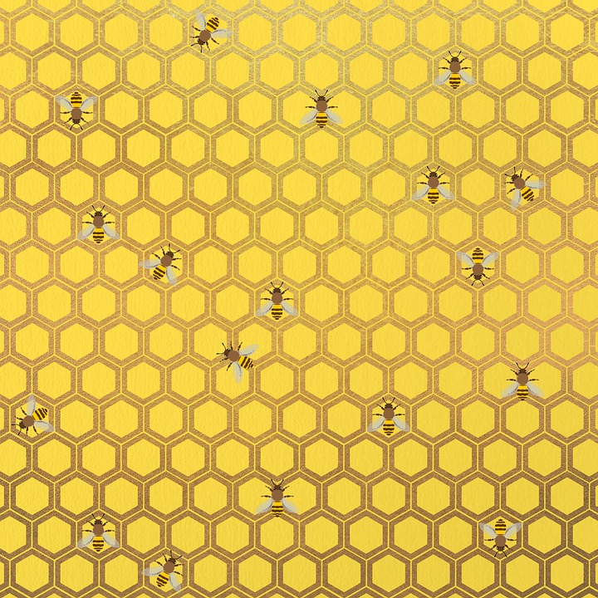
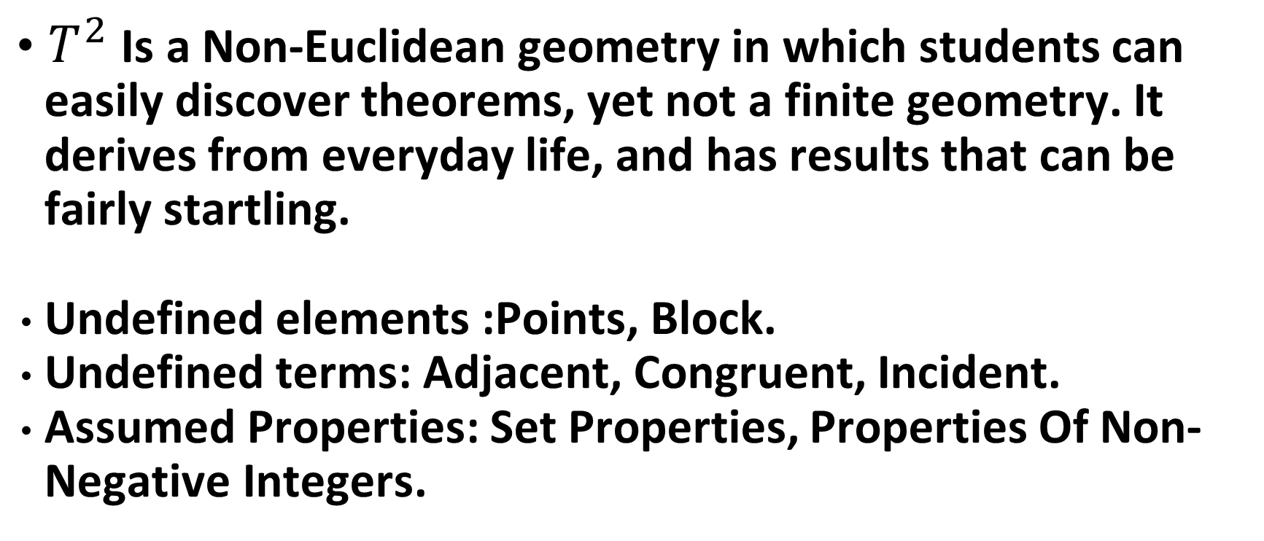
A Non Euclidean Geometry of Lattice Points:

Slide 9
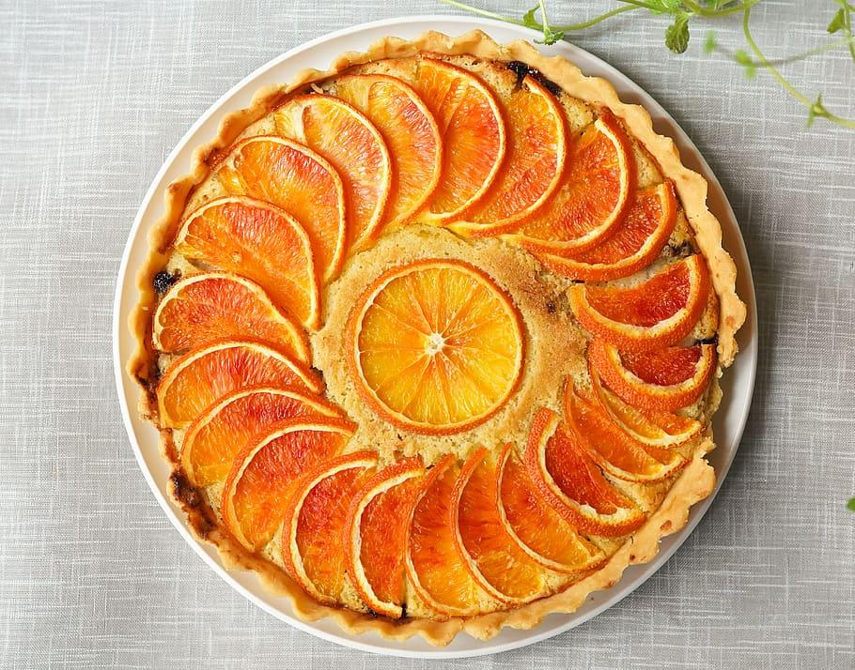
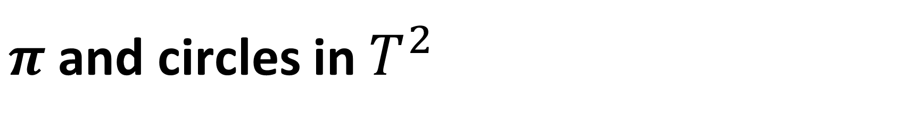
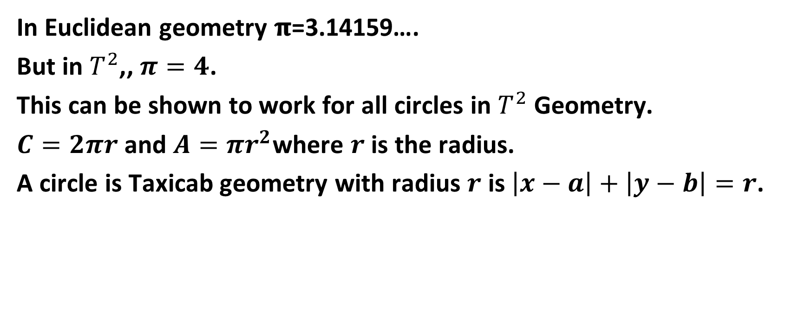
Definition of Circle: A circle is the set of all points equidistant from a single point.

Slide 10
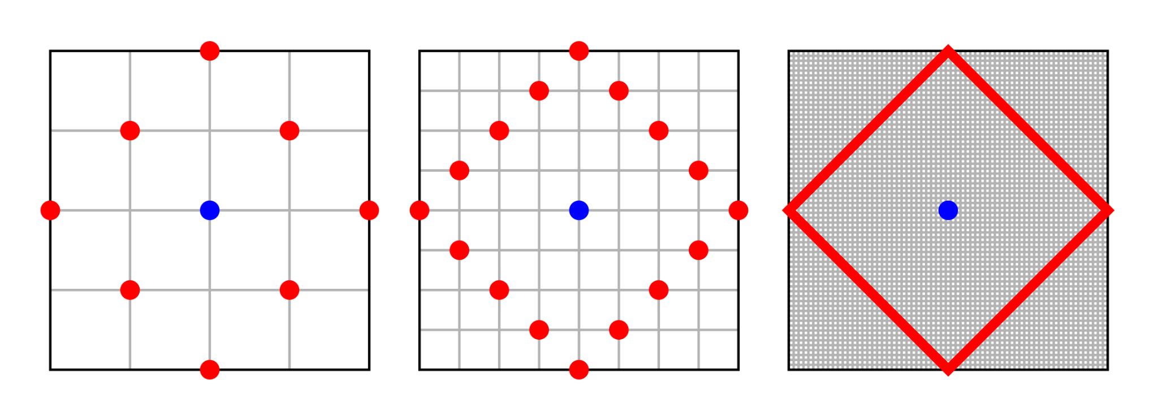


Slide 11

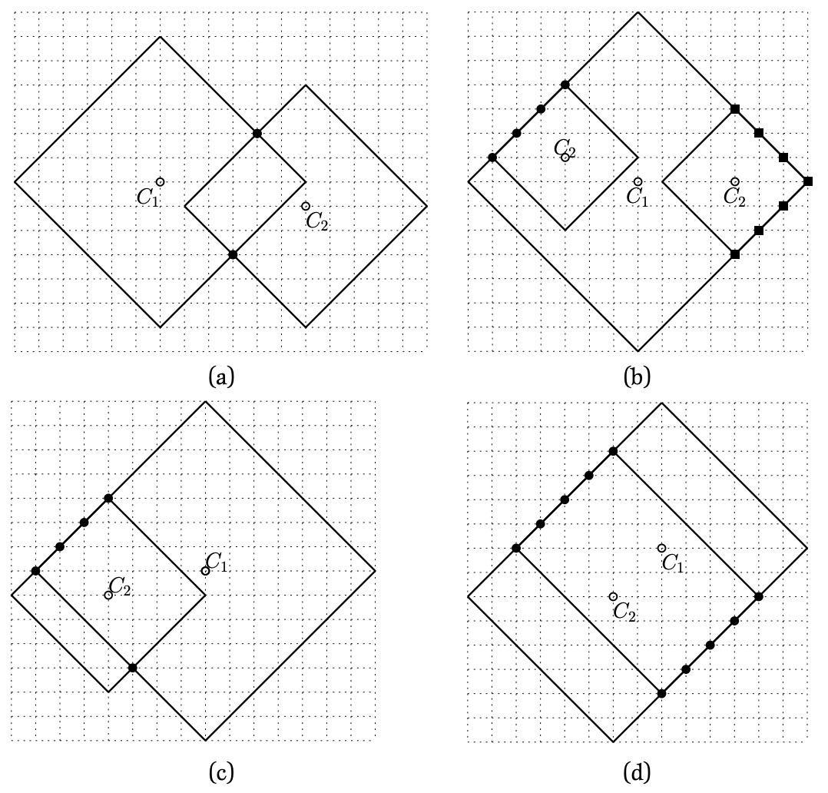

Slide 12
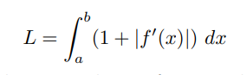
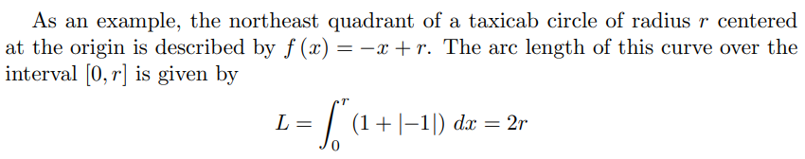
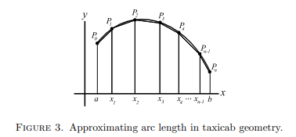
Approximating Arc Length

Slide 13
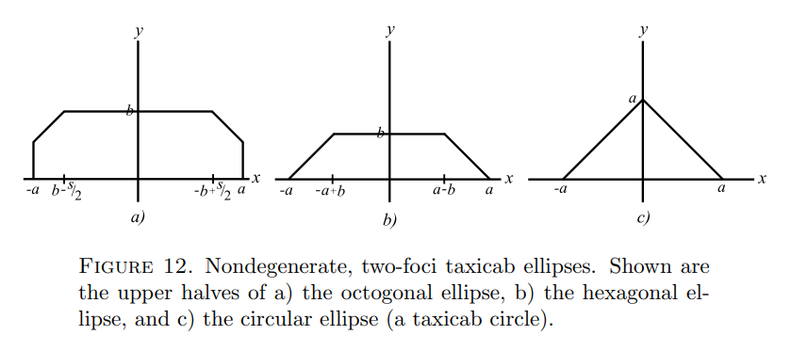

Slide 14
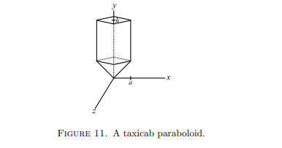
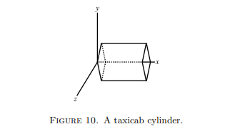
Taxicab Cylinder and Paraboloid

Slide 15
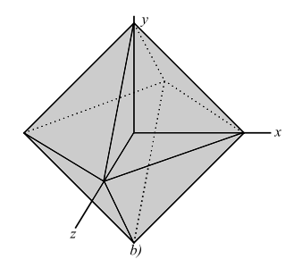
A Taxicab Sphere aka Octahedron

Slide 16
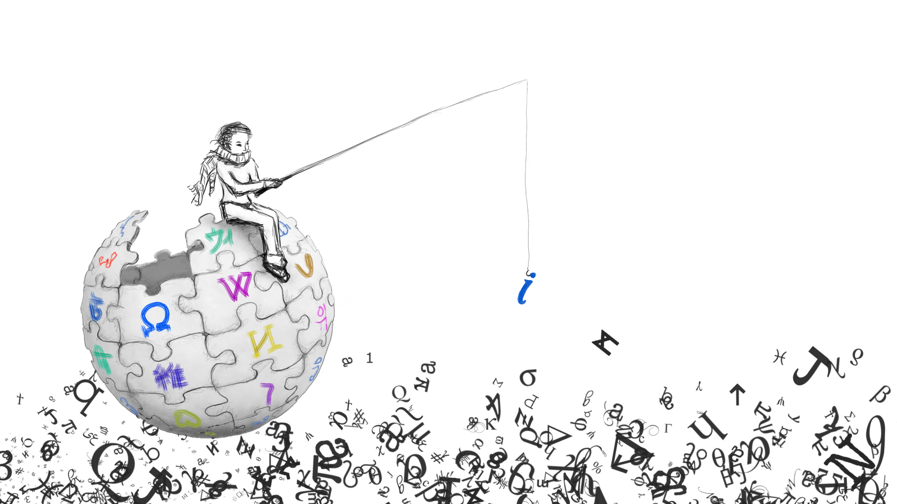
Sources:
https://www.jstor.org/stable/pdf/27958592.pdf https://www.jstor.org/stable/pdf/24339809.pdf
https://scholarworks.umt.edu/cgi/viewcontent.cgi?article=1018&context=tme
https://dergipark.org.tr/en/download/article-file/775591

